Slide 1
FifTH GRADE PARENT ORIENTATION SEPTEMBER 12, 2018

Slide 2
Fifth Grade ELA
Purpose:
The purpose of ELA is to strengthen students’ reading, writing, speaking, and listening skills

Slide 3
English Language Arts
Students in 5th grade should experience a balance of literature and informational texts
Students will have opportunities to engage with a variety of topics and texts.
Writing activities and discussions about texts will support language development and knowledge building.
ELA standards are divided into the following areas
Reading Standards (Literature and Informational Text)
Writing Standards
Speaking and Listening Standards
Language Standards

Slide 4
Anthology Scott Foresman Reading Street The textbook is available on-line at pearsonrealize.com
Each unit offers a variety of genres…
Expository nonfiction
Narrative nonfiction
Realistic fiction
Historical fiction
Poetry
Biography and Autobiography
Unit themes include…
Meeting Challenges
Doing the Right Thing
Inventors and Artists
Adapting
Adventurers

Slide 5
Family Times
The Grammar and Vocabulary focus for each new selection will be shared in the “Family Times”. Expect to see one every other week. It is a purple sheet that should be in the ELA folder.
Activities described in the Family Times are made for further exploration. These can be done at home for extra credit. Parents need to provide a signature with the activity or a short description.
Vocabulary will assessed every week. The first time will be a quiz. Then there is always a vocabulary section on the final test. It is essential that students spend some time studying these words at home.

Slide 6
A Fluent Reader…
recognizes plot of a story
recognizes problem and solution in a story
evaluates a character's actions or behaviors
uses a variety of clues to decode unfamiliar words
understands affixes
uses punctuation correctly
reads with expression
reads smoothly
selects a wide variety of books
silent sustained reading at least 30 minutes
confident
enjoys sharing favorite books
enjoys challenges
selects reading during free time
Information taken from http://www.mrsmcgowan.com/reading/stages.htm

Slide 7
Independent Reading
SCS’s homework policy includes independent reading for guidelines for each grade level.
Fifth graders are to read a minimum of 25 minutes each night.
An assignment focusing on a literary element is due at the end of each week.

Slide 8
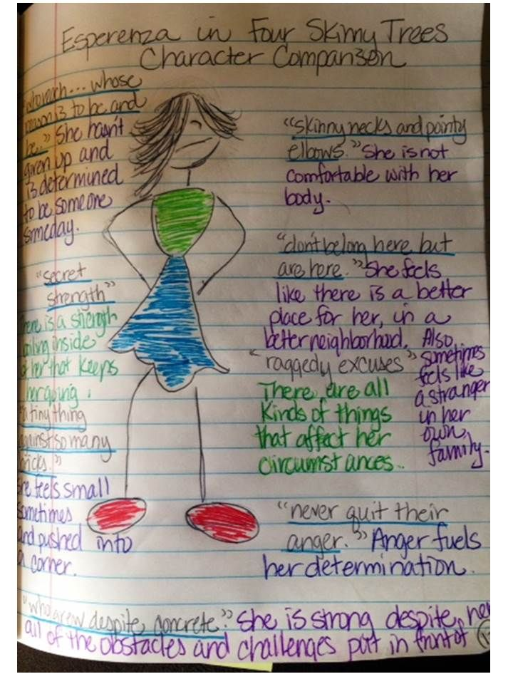
Reader’s Notebook…
Weekly responses should reflect your child’s best efforts.
All responses MUST be written on the correct page of the Reader’s Notebook.
Your child would benefit from you reading his/her response.
After reading the response, tell your child if any information is unclear to you.
Many times children know something in their head and just expect the reader to follow along without making certain that the thoughts are fully shared in the written response.

Slide 9
Writing 6 + 1 Traits of Writing
1. Ideas
2. Organization
3. Voice
4. Sentence Fluency
5. Word Choice
6. Conventions
+1 Presentation

Slide 10
Social Studies The Western Hemisphere
Pearson :my World Geography
Western Hemisphere text available on pearsonrealize.com
Grade 5 Social Studies is based on the history and geography of the Western Hemisphere.
Explores the development of cultures, civilizations, and empires.
Compares the government and economic systems of modern nations.
Covers a time span from prehistory into modern times.

Slide 11
Looking forward to a positive and productive year!
Thank you

