Slide 1
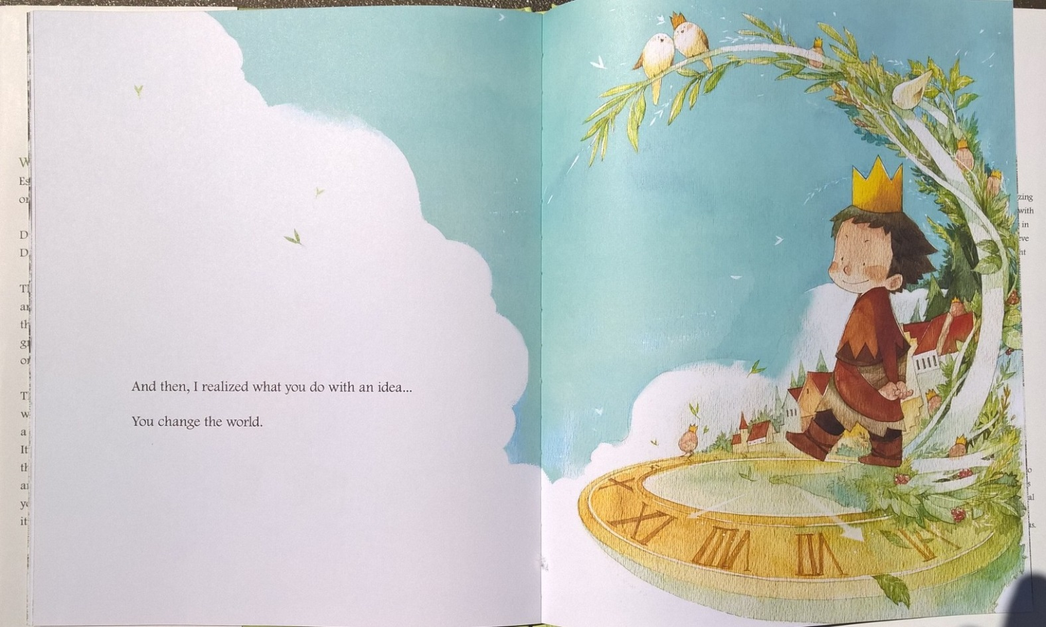
SIXTH GRADE PARENT ORIENTATION SEPTEMBER 12, 2018

Slide 2
English Language Arts
Students in 6th grade should experience a balance of literature and informational texts
Students will have opportunities to engage with a variety of topics and texts.
Writing activities and discussions about texts will support language development and knowledge building.
ELA standards are divided into the following areas
Reading Standards (Literature and Informational Text)
Writing Standards
Speaking and Listening Standards
Language Standards

Slide 3
A Fluent Reader…
recognizes plot of a story
recognizes problem and solution in a story
evaluates a character's actions or behaviors
uses a variety of clues to decode unfamiliar words
understands affixes
uses punctuation correctly
reads with expression
reads smoothly
selects a wide variety of books
silent sustained reading at least 30 minutes
confident
enjoys sharing favorite books
enjoys challenges
selects reading during free time
Information taken from http://www.mrsmcgowan.com/reading/stages.htm

Slide 4
Independent Reading
SCS’s homework policy includes guidelines for
independent reading for each grade level.
Sixth graders are to read a minimum of 30
minutes each night.

Slide 5
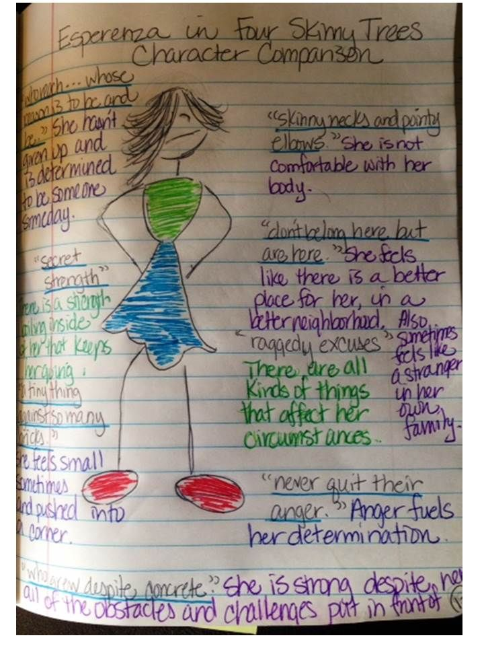
Reader’s Notebook…
Weekly responses should reflect your child’s best efforts.
All responses MUST be written on the correct page of the Reader’s Notebook.
Your child would benefit from you reading his/her response.
After reading the response, tell your child if any information is unclear to you.
Many times children know something in their head and just expect the reader to follow along without making certain that the thoughts are fully shared in the written response.

Slide 6
Anthology Scott Foresman Reading Street… Textbook is available at pearsonrealize.com
Unit themes include…
Loyalty and Respect
Space and Time
Challenges and Obstacles
Explorers, Pioneers, and Discoveries
Exploring Cultures
Each unit has a variety of genres..
Expository nonfiction
Narrative nonfiction
Realistic fiction
Historical fiction
Poetry
Biography and Autobiography

Slide 7
Family Times
A Family Times page will be given for each Anthology read. It will be a Green paper in the ELA folder.
All activities can be done for Extra Credit. They must be turned into me with parent signature.
Vocabulary will be tested every week. The first time it will be a quiz. Then there is always a vocabulary section on the final test. It is essential that students spend some time studying these words at home.

Slide 8
Writing 6 + 1 Traits of Writing
1. Ideas
2. Organization
3. Voice
4. Sentence Fluency
5. Word Choice
6. Conventions
+1 Presentation

Slide 9
Social Studies The Eastern Hemisphere
Scott Foresman: The World
Textbook is available on-line!
Grade 6 Social Studies is based on the geography and history of the Eastern Hemisphere
Explores the development of cultures, civilizations, and empires
Examines interactions between societies
Begin making connections between the past and the present
cover a time span from pre-history into the 1300s.

Slide 10
Planner
Students are responsible for updating the planner with upcoming assignments.
The planner will also be the place that I use to share information with parents.
It is the responsibility of the student to ensure that a parent signs the planner before the start of each new week.

Slide 11
Our Social Contract
Groups of 5th and 6th graders worked together to create our Social Contract.
Together we agreed on the contract that is on display.
Please encourage your child to reflect on our contract by asking him/her to share with you his/ her rating on how well the contract was followed on a given day.
Use a scale of 1-10 with 10 being the best

Slide 12
Purple Pride
Each month, students will have the opportunity to participate in monthly incentive activities.
Purple Pride students follow the social contract throughout the school day. This includes being responsible and having their assignments completed throughout the month.

Slide 13
I’m looking forward to a year of
sharing ideas
to change our world.
Thank you

